Slide 1
Wine variety Prediction
Malvika jadhav

Slide 2
Models Used
The following modelling algorithms have been used :
Decision tree Classifier
Random Forest Classifier
Adaboost Classifier
We compare the above models and choose the one with the most favorable metric value
Here I have considered ‘accuracy’ as deciding metric

Slide 3
Features
The final list of features used for modeling is as follows:
country
designation
price
province
region_1
region_2
winery
description_length

Slide 4
Model Accuracy for train data
Model | Accuracy
Decision tree classifier | 49.9%
Random forest classifier | 53.3%
Adaboost classifier | 50.9%

Slide 5
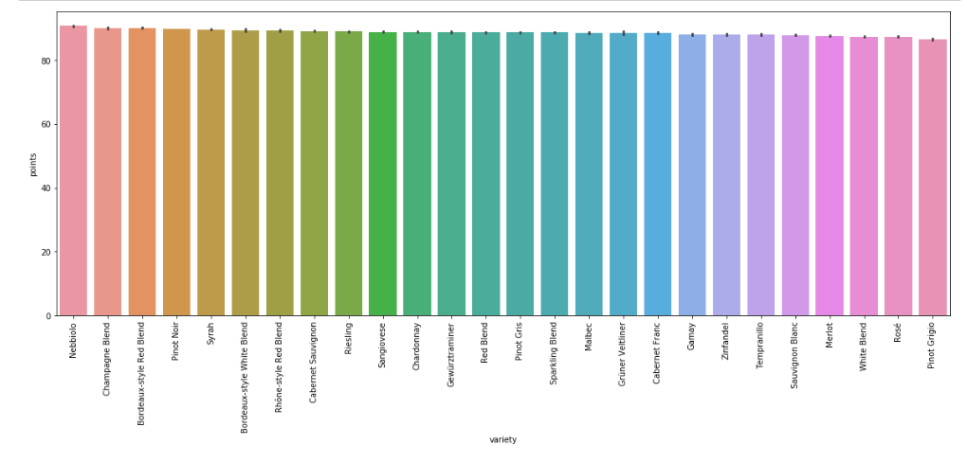
Important visualizations: I
The above plot is variation of points for different wine varieties as wee can see they are almost constant and hence ‘points’ cannot be considered a significant predictor

Slide 6
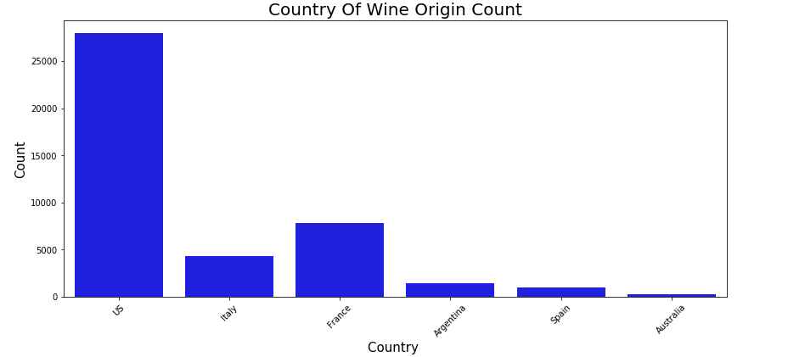
Important visualizations: II
Unlike conventional trend the highest amount of wine manufactured according to this data is from United States instead of Italy, France or Spain.

Slide 7
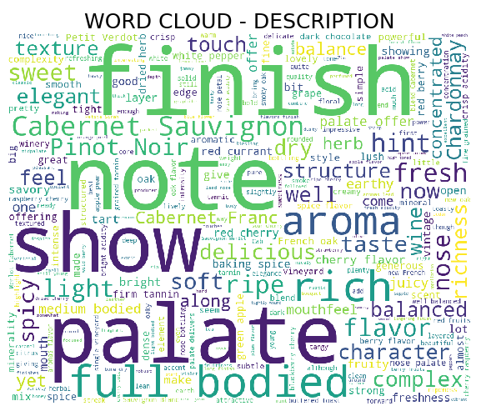
Important visualizations: III
The word cloud for review descriptions indicates that the aroma (palate) and the finish note (lingering after taste) are the main factors that affect taster’s opinions about the wine

Slide 8
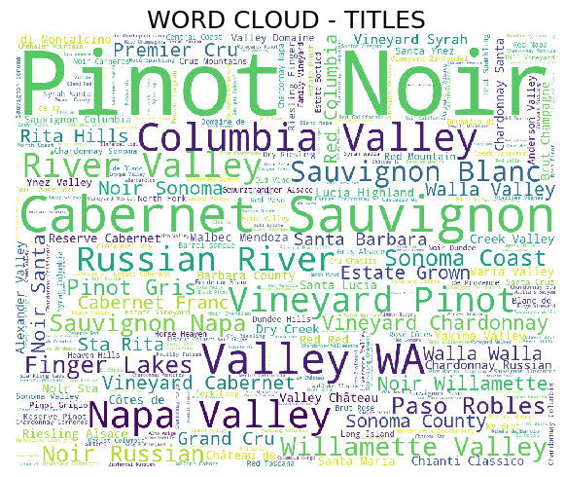
Important visualizations: IV
From the above word cloud we can see that Pinot Noir is the most reviewed wine variety

Slide 9
Actionable Insights
1. The ratings given by the used are nearly around 90-100 for every wine, this means that the system of rating need to be updated or method of collection of rating points needs to be changed
2. Palate and finish notes of a wine are key factors on which wine taster’s have formed their opinion as per review descriptions. Extra care can be taken before recommending wine to critics or frequent customers about preservation of aroma notes for wine.
3. The best rated wine according to the data is ‘Bordeaux-style Red Blend’. Depending on the winery the same wine can be bought from 1500 to 150(currency unit). An economical shopper will compare prices before making a purchase so the description on the site must specify what factors make the prices so different.

Slide 10
Actionable Insights
4. ‘Cabernet Sauvignon’ is the worst rated wine, from site’s perspective the action would be to decide whether or not to continue listing the wine (depending on other factors like its demand).
5. ‘Yao Ming’ is the winery with highest average price per wine bottle. All the listed bottles are of the variety ‘Cabernet Sauvignon’, but the prices are different. Before listing the wines on site information about this price difference needs to be collected from the winery. Similar approach should be adopted for more such cases

